Slide 1
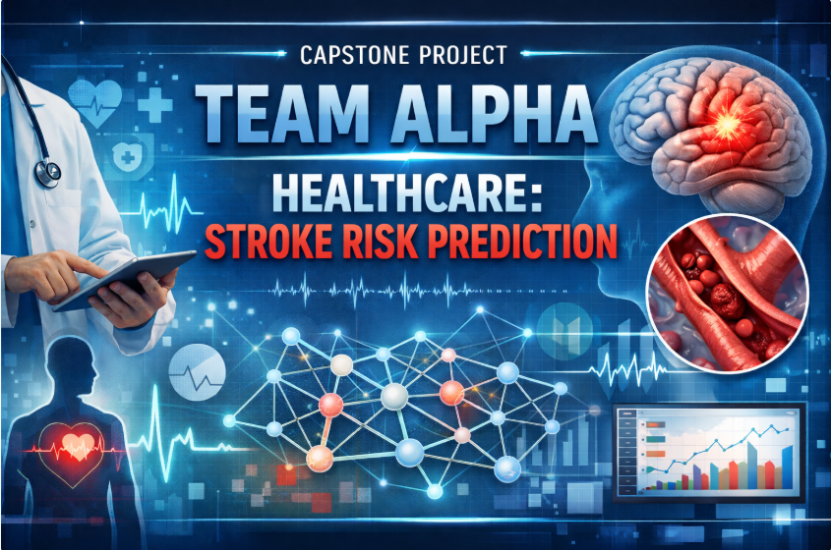

Slide 2
Introduction
Stroke is still one of the leading causes of death and long-term disability worldwide. Many stroke cases occur without early warning, making timely prevention difficult.
Healthcare providers need effective tools to identify individuals at elevated risk before a stroke occurs. However, analyzing multiple medical and lifestyle factors manually can be challenging and time-consuming.
This project aims to develop a machine learning classification model that predicts the likelihood of stroke using patient demographic, lifestyle, and medical data, enabling healthcare professionals to support early detection and preventive intervention.

Slide 3
What is Stroke
A stroke (also called a cerebrovascular accident or brain attack) is a serious medical emergency that occurs when blood flow to part of the brain is suddenly interrupted or reduced. Without oxygen and nutrients from blood, brain cells begin to die within minutes, leading to permanent brain damage, disability, or death if not treated quickly.
Key Determinants of Stroke Risk :
Age
Hypertension (High Blood Pressure)
Heart Disease
Average Glucose Level
Body Mass Index (BMI)
Smoking Status
Gender
Work Type
Residence Type (Urban/Rural)
Marital Status

Slide 4
Types of Stroke
Stroke Type | Cause | Frequency
Ischemic Stroke | Blood clot blocking artery | ~85%
Hemorrhagic Stroke | Ruptured blood vessel causing bleeding | ~15%
Transient Ischemic Attack (TIA) | Temporary blood flow blockage | Warning sign

Slide 5
Model Interpretation (Stroke Prediction)
The model correctly predicted 948 non-stroke-risk patients.
Only 6 out of 50 stroke-risk patients were correctly predicted.
44 high-risk patients were missed.
24 Patients predicted at risk but actually not
Key Clinical Insight
Although the accuracy is high (93.3%), the
sensitivity is very low (12%), meaning the model
fails to identify most stroke-risk individuals due to
severely Imbalanced Dataset.
In medical prediction systems, sensitivity is
usually more important than accuracy, because
missing high-risk patients may lead to preventable
stroke events.

Slide 6
Clinical Evaluation of Stroke Risk Prediction Model
Metric | Formula | Value | Interpretation
Accuracy | (TP + TN) / Total | 0.90 | Correctly classifies most patients
Sensitivity | TP / (TP + FN) | 0.32 | Many stroke-risk patients missed
Specificity | TN / (TN + FP) | 0.975 | Identifies non-stroke patients well
Precision | TP / (TP + FP) | 0.20 | Few predicted strokes are correct
NPV | TN / (TN + FN) | 0.96 | Predicted low-risk patients likely correct
F1-score | 2 × (Prec × Rec) / (Prec + Rec) | 0.24 | Low balance between precision & recall
ROC–AUC | Area under ROC curve | 0.81 | Good discrimination overall

Slide 7
Feature Importance in Stroke Risk Prediction (Gradient Boosting)
Feature | Importance
Age | 0.63
Smoking Status | 0.14
Work Type | 0.11
Avg Glucose Level | 0.03
BMI | 0.02
Ever Married | 0.01
Gender | 0.01
Residence Type | 0.005
Heart Disease | 0.003
Hypertension | 0.002
Age is the dominant predictor of stroke risk, contributing over 60% to the model’s decisions. Smoking status and work type are also important, while clinical factors like heart disease and hypertension have minimal impact. This suggests that demographic and lifestyle factors play a larger role in stroke prediction in this dataset.

Slide 8
Early Intervention Strategies
🩺 Early Risk Screening Identify high-risk patients through regular health checkups and predictive models.
💓 Blood Pressure Control Monitor and manage hypertension through medication and lifestyle adjustments.
🍎 Diabetes & Glucose Management Encourage regular blood sugar monitoring and healthy diet plans.
🚭 Lifestyle Improvement Programs Promote smoking cessation, exercise, healthy diet, and weight management.
👨‍⚕️ Personalized Preventive Care Provide targeted monitoring and treatment plans for patients identified as high risk.

Slide 9
Ethical Considerations in Medical Risk Prediction
🔒 Patient Data Privacy Ensure secure storage and responsible handling of sensitive health data.
⚖️ Algorithmic Fairness Use diverse and representative datasets to prevent biased predictions.
🔍 Transparency & Explainability Healthcare professionals should understand how the model generates predictions.
👩‍⚕️ Human Oversight AI systems should assist doctors, not replace clinical judgment.
⚠️ Managing Prediction Errors Monitor false positives and false negatives to avoid harmful medical decisions.

Slide 10
Conclusion
Machine learning models can significantly improve early detection of stroke risk, enabling healthcare providers to implement preventive strategies such as lifestyle interventions, blood pressure management, and personalized treatment plans.
However, ethical considerations including data privacy, algorithmic fairness, transparency, and human oversight must be addressed to ensure responsible and trustworthy use of predictive systems in healthcare.

